Slide 1
Cross platform mobile development
Piotr Włodek, Team Manager

Slide 2
Agenda
Clone https://github.com/pwlodek/MobileIntro.git
Mobile development architecture
Introduction to Xamarin
Introduction to Xamarin Forms
XAML, MVVM, data binding
Introduction to Azure
Cosmos DB, Web Apps, Web Jobs, Service Bus

Slide 3
Architecting mobile apps

Slide 4

Silo Approach
iOS
Android
Windows
Objective-C
Xcode
Java
Android Studio
C#
Visual Studio
No shared code • Many languages & development environments • Multiple teams
Notes:
Multiple Teams
Multiple Code Bases
Expensive & Slow
Positive = Great apps delivered to user’s platform
Negative = Development hampered by multiple code bases & fragmentation

Slide 5
Write Once, Run Anywhere
Lua
Javascript
Actionscript
HTML+CSS
App Generator
Limited native API access • Slow performance • Poor user experience
Notes:
Unhappy Users
Unhappy Developers
Increase in Abandoned Apps
Limited to what is implemented

Slide 6
Enter Xamarin
iOS C# UI
Android C# UI
Windows C# UI
Shared C# Mobile
Shared C# codebase • 100% native API access • High performance

Slide 7
Windows APIs
Microsoft.Phone
Microsoft.Networking
Windows.Storage
Windows.Foundation
Microsoft.Devices
System.Net
System
System.IO
System.Linq
System.Xml
System.Data
System.Windows
System.Numerics
System.Core
System.ServiceModel
C#

Slide 8
iOS – 100% API Coverage
MapKit
UIKit
iBeacon
CoreGraphics
CoreMotion
System.Net
System
System.IO
System.Linq
System.Xml
System.Data
System.Windows
System.Numerics
System.Core
System.ServiceModel
C#

Slide 9
Android – 100% API Coverage
Text-to-speech
ActionBar
Printing Framework
Renderscript
NFC
System.Net
System
System.IO
System.Linq
System.Xml
System.Data
System.Windows
System.Numerics
System.Core
System.ServiceModel
C#

Slide 10
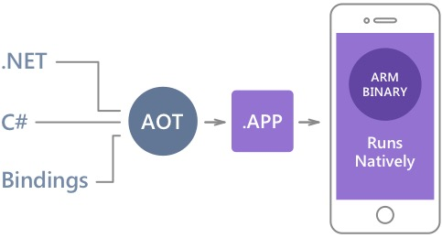
Native Performance
Xamarin.iOS does full Ahead Of Time (AOT) compilation to produce an ARM binary for Apple’s App Store.
Xamarin.Android takes advantage of Just In Time (JIT) compilation on the Android device.

Slide 11
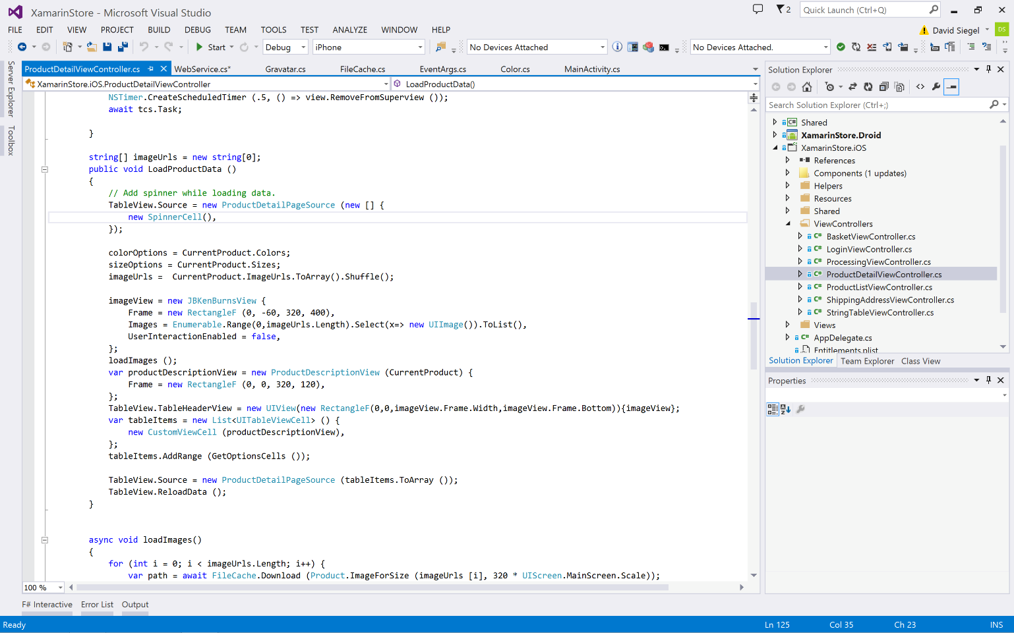
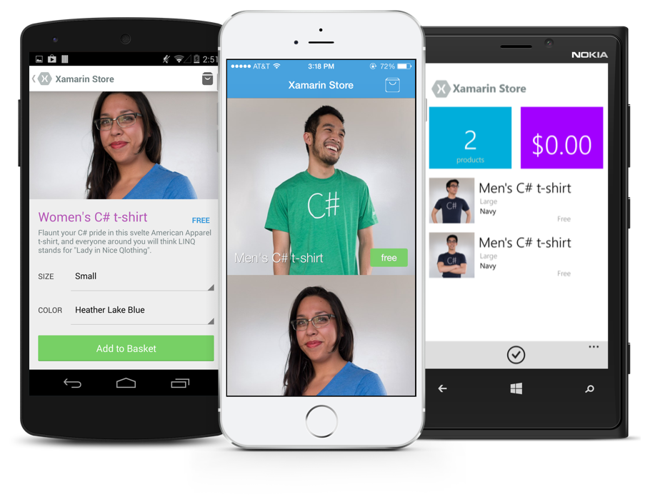
Anything you can do in Objective-C, Swift, or Java can be done in C# with Xamarin.
Notes:
Coming up next is bubbles

Slide 12
Building UI

Slide 13



Traditional UI approach
iOS C#
Android C#
Windows C#
Shared C# Logic
3 Native User Interfaces
Shared App Logic

Slide 14
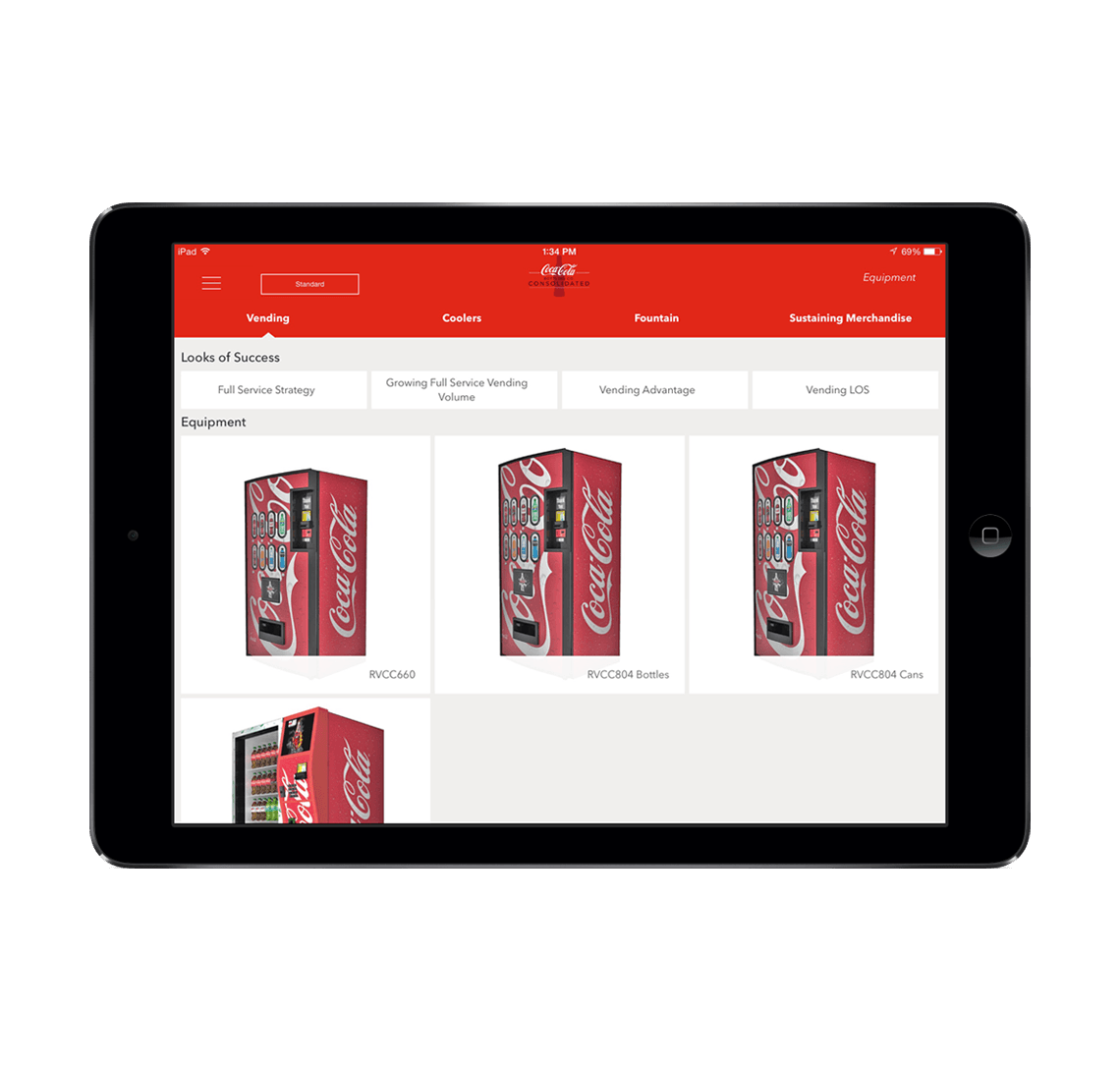
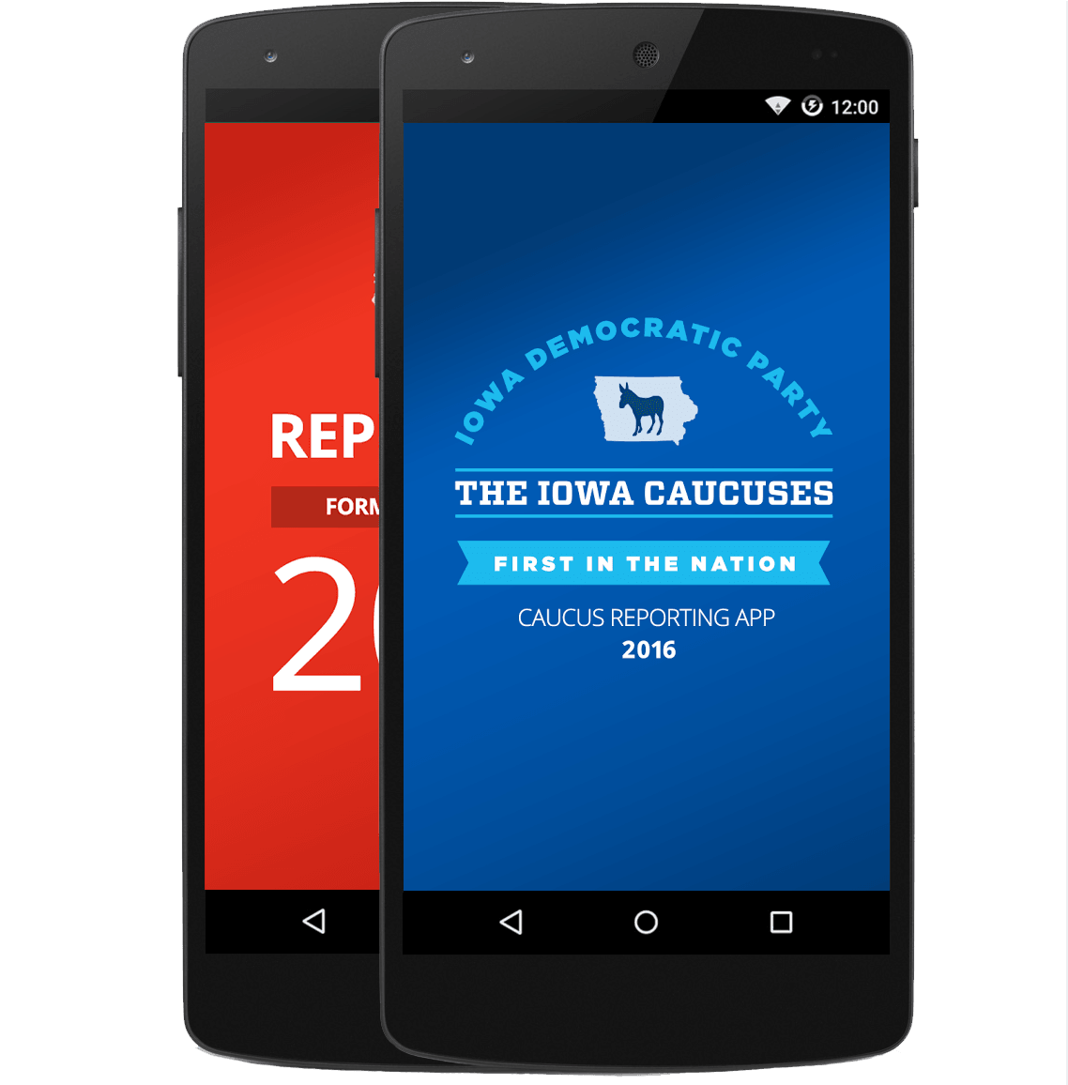
Xamarin.Forms approach
Shared UI Code
Shared C# Logic
Shared User Interface
Shared App Logic

Slide 15
Development Experience

Slide 16
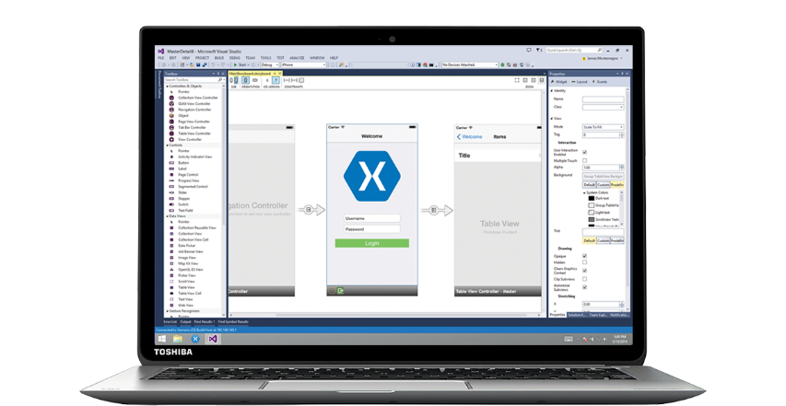
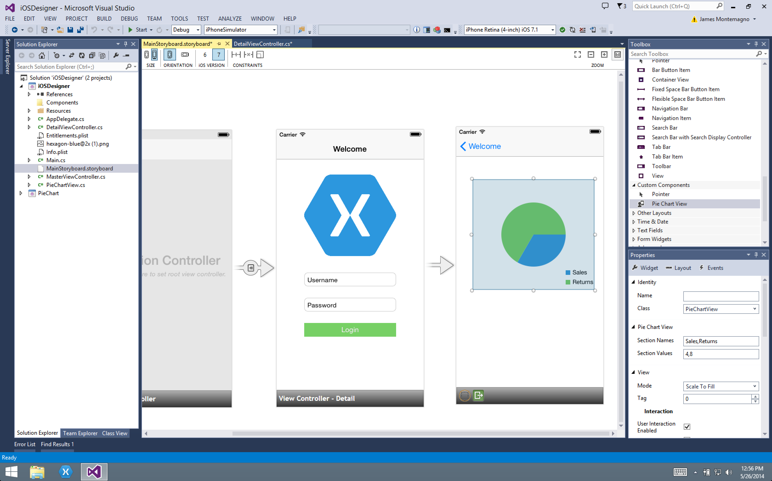
Xamarin for Visual Studio

Slide 17

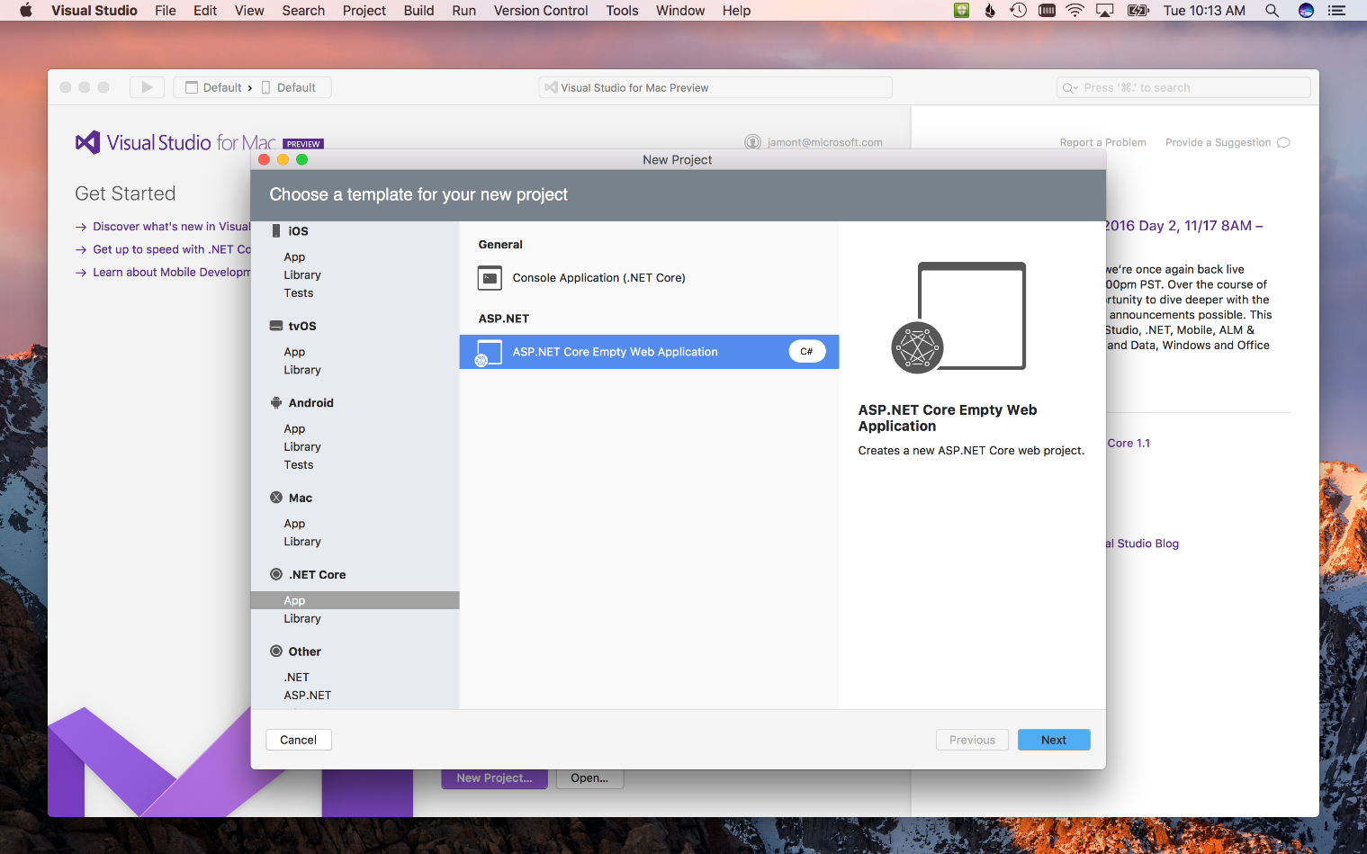
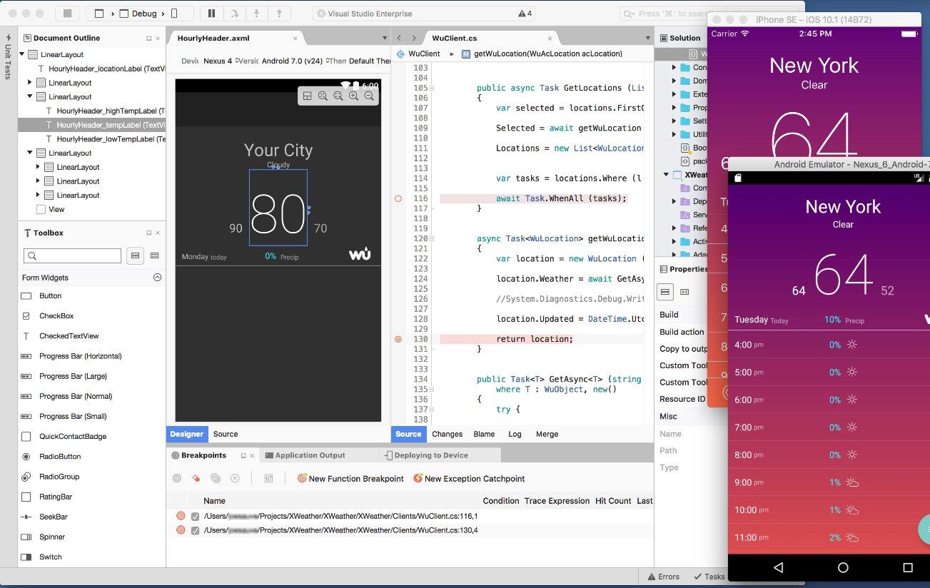
Visual Studio for Mac
iOS, Android, & macOS
.NET development
.NET Core & ASP.NET Core
Tools for Azure
Notes:
The biggest surprise was the brand new Visual Studio for Mac!
In preview today and is the next evolution of Xamarin Studio.
Includes Azure Tools and .NET Core work loads. More in the future.

Slide 18
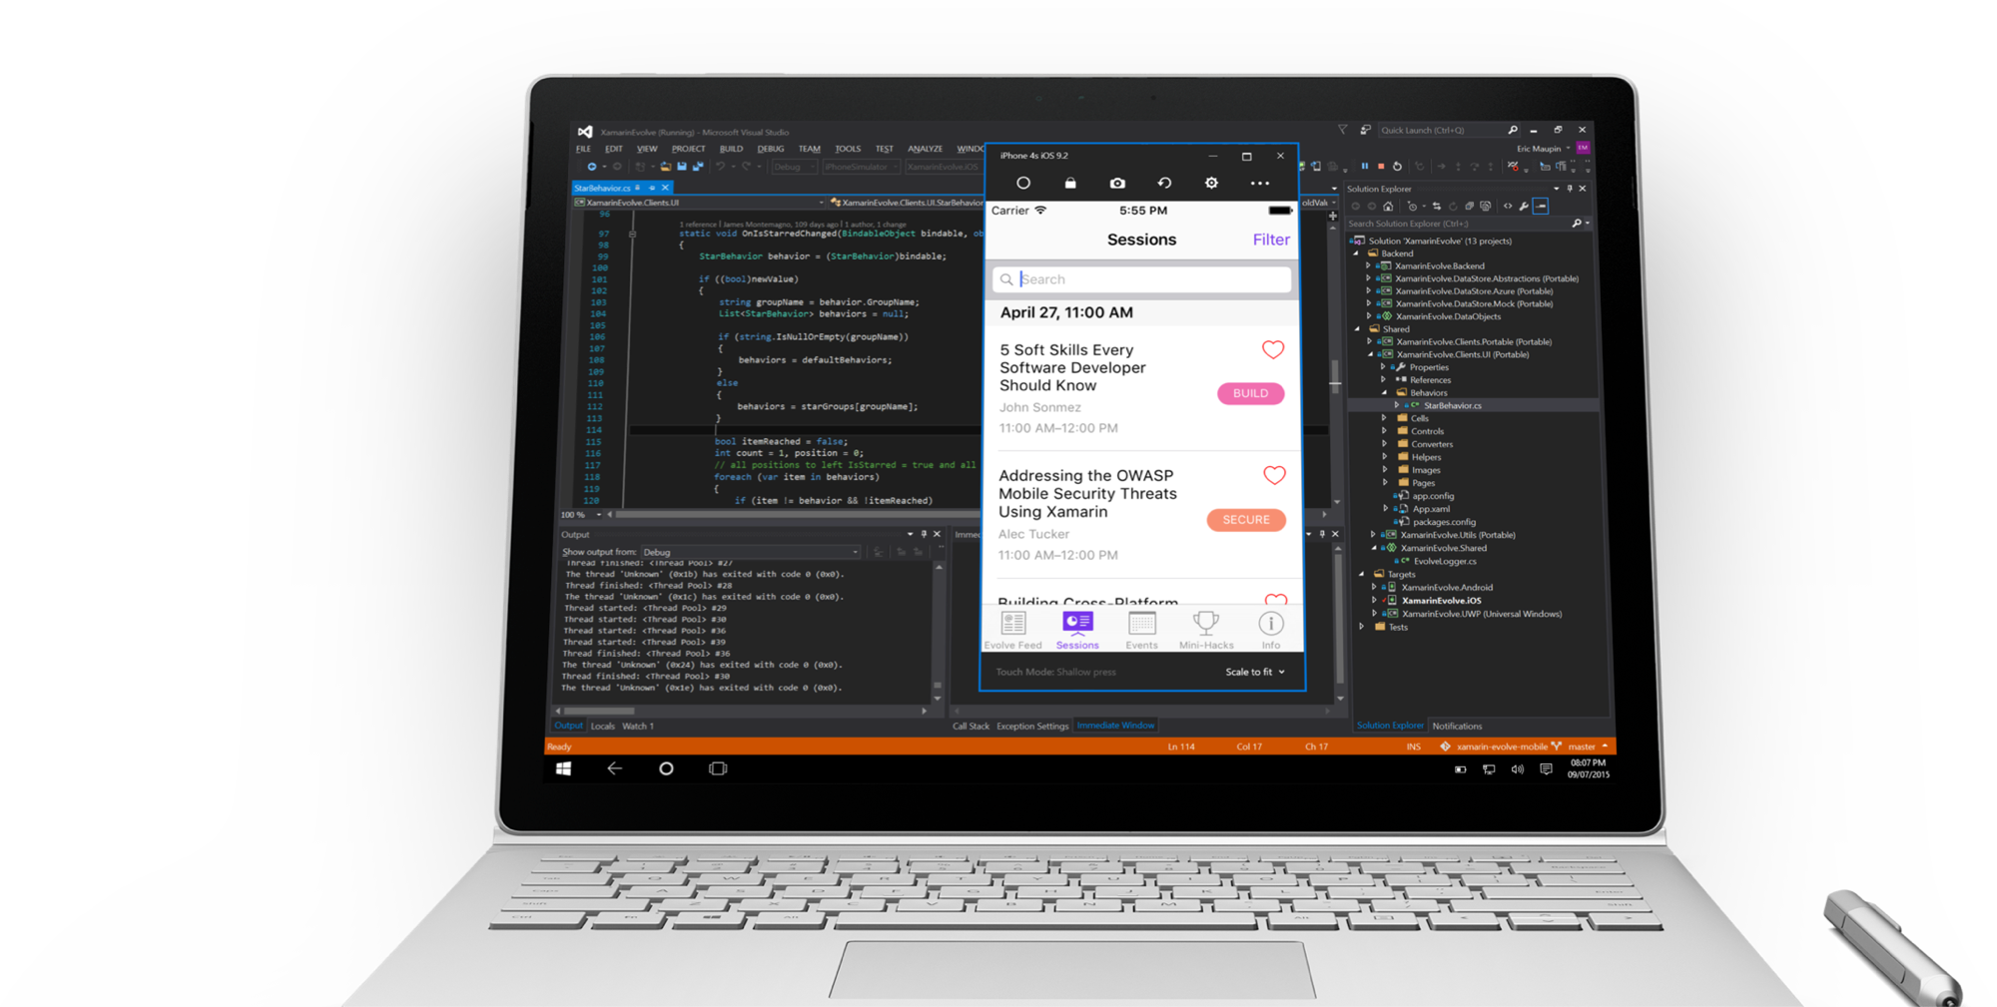
Visual Studio iOS Simulator Remoting
Multi-Touch Enabled
Pressure Sensitive
Super Fast
Rotate, screenshots, location changes
Never leave VS
*Requires Visual Studio Enterprise

Slide 19
Meet Xamarin Forms

Slide 20
Xamarin + Xamarin.Forms
iOS C# UI
Android C# UI
Windows C# UI
Shared UI Code
Shared C# Backend
Shared C# Backend
Traditional Xamarin Approach
With Xamarin.Forms: More code-sharing, all native

Slide 21

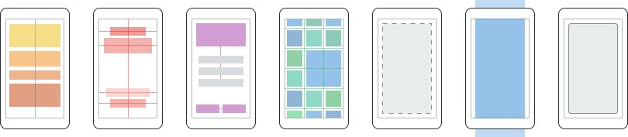
Layouts
Pages
Content
MasterDetail
Navigation
Tabbed
Carousel
Stack
Absolute
Relative
Grid
ContentView
ScrollView
Frame
Notes:
Inside of a page are layouts
A lot of options from something simple like a stack panel to complex and powerful grids

Slide 22
Controls
ActivityIndicator
BoxView
Button
DatePicker
Editor
Entry
Image
Label
ListView
Map
OpenGLView
Picker
ProgressBar
SearchBar
Slider
Stepper
TableView
TimePicker
WebView
EntryCell
ImageCell
SwitchCell
TextCell
ViewCell
Notes:
You have more than 40 controls, layouts, and pages to mix and match from.
These are all of the controls you have out of the box, you can of course create your own.
What is unique is you get the native control and have access to it.
Consider an Entry Field
On iOS it is mapped to UITextField
Android it is EditText
Windows Phoen it is a TextBox

Slide 23
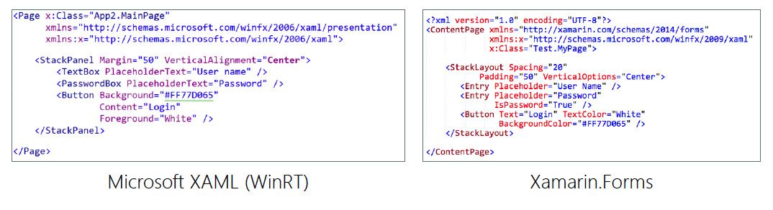
XAML for UI
Xaml is used to describe the UI
Separates the UI from behavior
Supports rich databinding

Slide 24
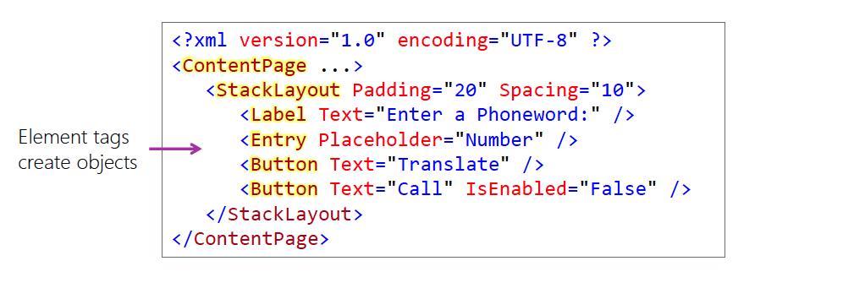
Describing a screen in XAML
XAML is used to construct object graph

Slide 25
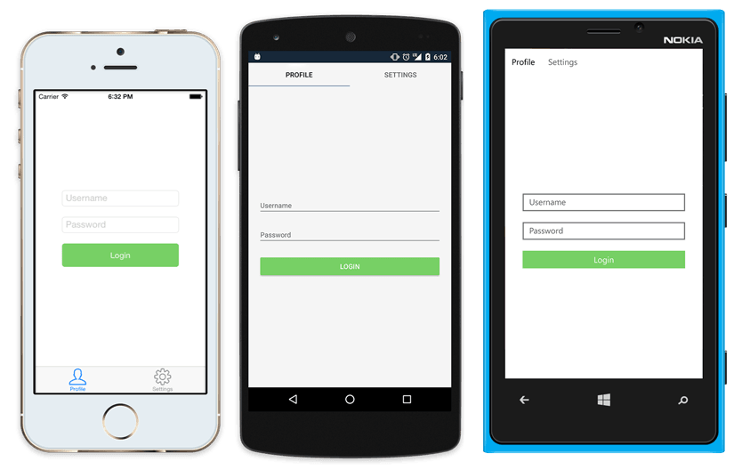
Native UI from shared code
<?xml version="1.0" encoding="UTF-8"?>
<TabbedPage xmlns="http://xamarin.com/schemas/2014/forms"
xmlns:x="http://schemas.microsoft.com/winfx/2009/xaml"
x:Class="MyApp.MainPage">
<TabbedPage.Children>
<ContentPage Title="Profile" Icon="Profile.png">
<StackLayout Spacing="20" Padding="20"
VerticalOptions="Center">
<Entry Placeholder="Username"
Text="{Binding Username}"/>
<Entry Placeholder="Password"
Text="{Binding Password}"
IsPassword="true"/>
<Button Text="Login" TextColor="White"
BackgroundColor="#77D065"
Command="{Binding LoginCommand}"/>
</StackLayout>
</ContentPage>
<ContentPage Title="Settings" Icon="Settings.png">
<!-- Settings -->
</ContentPage>
</TabbedPage.Children>
</TabbedPage>

Slide 26
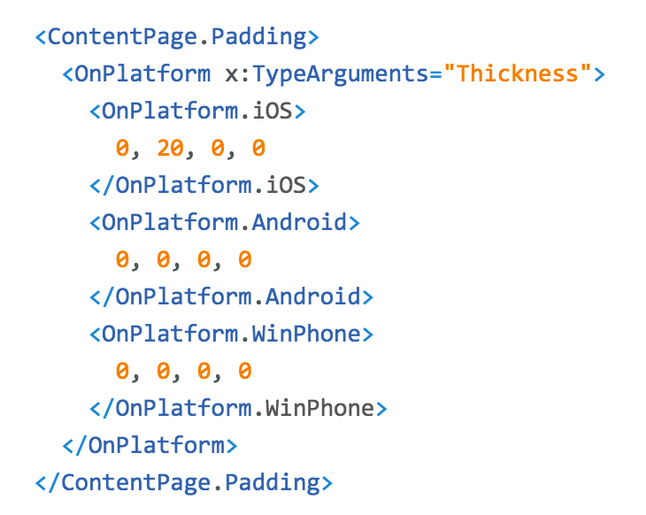
Platform
Customization

Slide 27
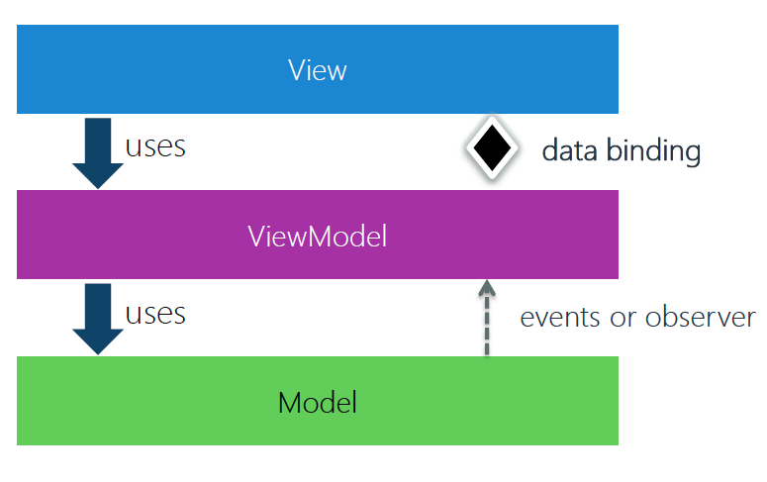
Model-View-ViewModel (MVVM)
MVVM is a layer separated presentation pattern made popular by other XAML based frameworks

Slide 28
MVVM Frameworks
MVVM Cross (Mvx)
MVVM Light
Caliburn

Slide 29
Finally, show me some code!

Slide 30
Let’s meet Azure

Slide 31
Microsoft Azure
Microsoft Public Cloud
Subscription based
2nd larges public cloud after Amazon WS
Cloud Terminology
Infrastructure as a Service
Platform as a Service
Software as a Service

Slide 32
Resources
Resource group – logical container
App Service – hosts web api
App Service plan – determines hosting environment (CPU, memory, disk, etc.)
Web Job – process that is executed continuously
Service Bus – robust messaging
Brokered messages
Relay
Storage Account – blob storage, files
Cosmos DB – NoSQL database

Slide 33
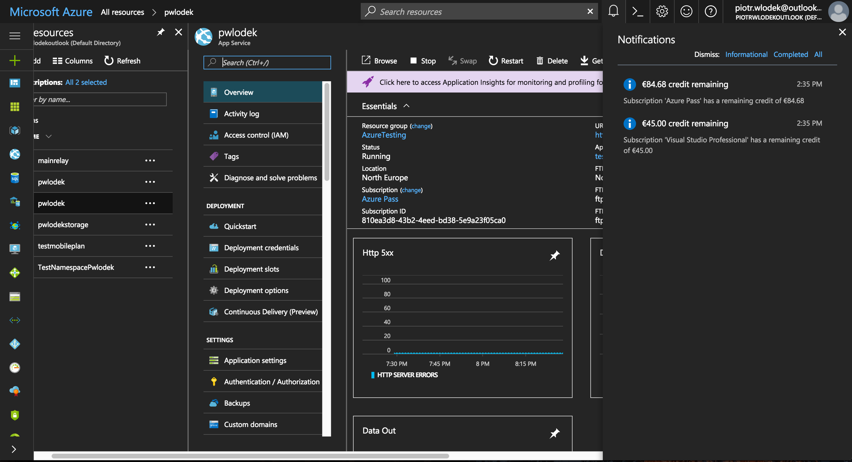
Azure Resource Provisioning
Azure Portal – portal.azure.com
Powershell
CLI
ARM Templates

